Slide 1
Architecting E-Commerce Solutions with .NET & Azure Cloud
Rajneesh Hajela
18+ years,
.NET Azure Solution Architect

Slide 2
Business Alignment
Architecture framework
Strategy
cost optimization & governance, and compliance.
Security, Scalability

Slide 3
Objectives of the workshop
Introduction to E-Commerce Architecture: A brief overview of modern e-commerce platform needs.
Deep Dive into .NET Core and Microservices: How to structure an e-commerce platform with .NET Core using microservices architecture.
Leveraging Azure Cloud Services: Discuss Azure services like AKS (Azure Kubernetes Service), Cosmos DB, Azure Functions, APIM (API Management), Azure App Services, and Azure Logic Apps.
AI-Driven Solutions for E-Commerce: Using Azure AI to personalize customer experiences, automate product recommendations, and optimize business processes.
Cost Optimization with Azure: Highlight how Azure’s pay-as-you-go model and services like Azure DevOps and Azure Automation help lower infrastructure and operational costs.

Slide 4
Introduction to E-Commerce Architecture:
A brief overview of modern e-commerce platform needs.

Slide 5
Pain Points: ❌ Scalability issues due to tightly coupled services. ❌ Slow release cycles and high deployment risks. ❌ Performance bottlenecks with increasing user load. ❌ Security vulnerabilities due to shared codebase. ❌ Difficulties in adopting cloud-native solutions.
Why Microservices? (Business & Technical Benefits)
✔️ Business Agility: Faster feature releases & reduced time-to-market. ✔️ Scalability: Independent scaling of services based on demand. ✔️ Resilience: Fault tolerance with service isolation. ✔️ Security: Improved data protection with zero-trust architecture. ✔️ Cost Optimization: Pay-as-you-go cloud resources instead of over-provisioning.

Slide 6
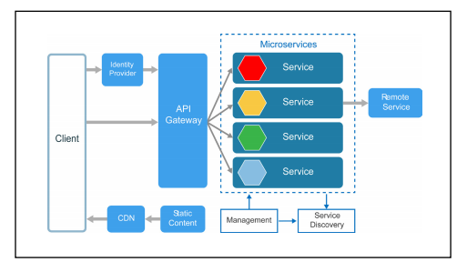
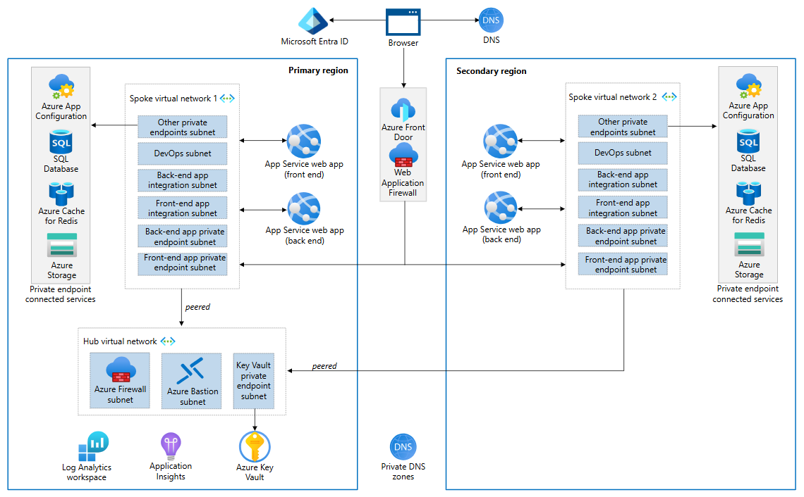
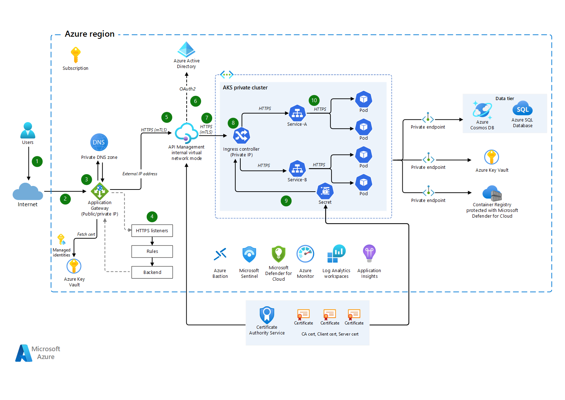
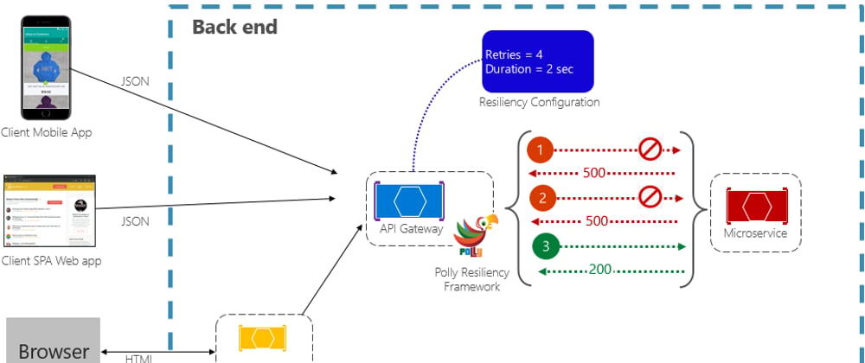
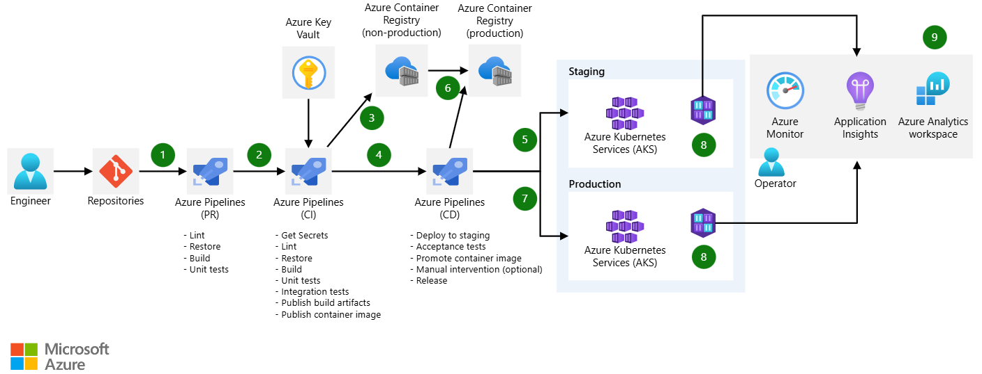
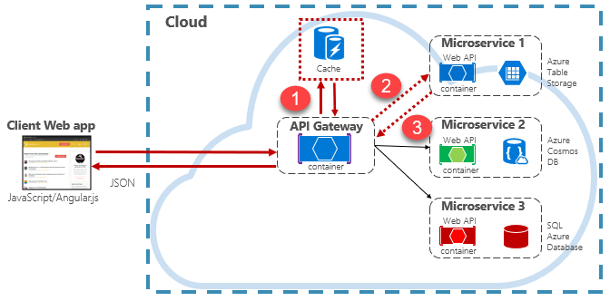
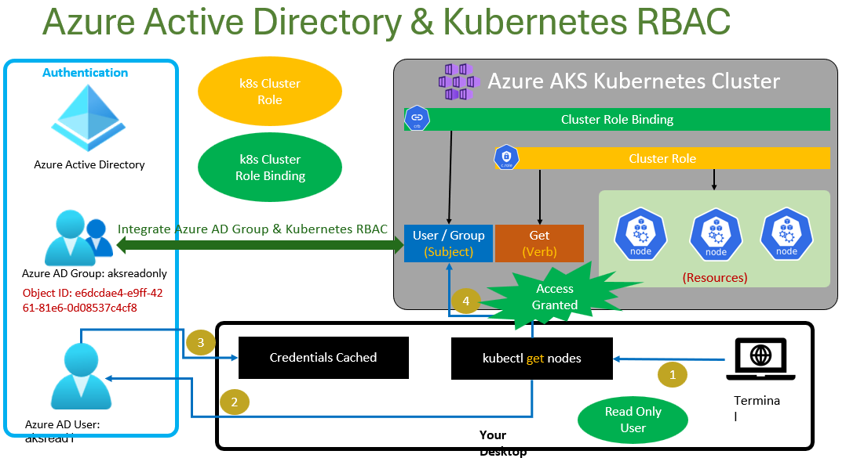
Identity Provider, Angular 18, Web API(.NET Core 8.0) (Planning- 6R,ALZ, WAF, and CAF, DDD) Security, Logging, Monitoring, Scalability, Deployment, Caching, Integration, Networking, Costing
✅ High Throughput (handling spikes during flash sales) ✅ Low Latency (fast order processing) ✅ Resilience & Fault Tolerance (prevent message loss) ✅ Scalability (handle increasing demand) ✅ Event-Driven Architecture (for microservices)
Security
Compliance
(General Data Protection Regulation)
Logging
Monitoring
Communication
Backup & DR
High Available
Scalable
Reliable
Flexible
Available
MASS Transit,NServiceBus
Health Check
Communication
Caching
Blue Green Deployment
RTO RPO
Docker
DevOps CICD Pipeline
Deployment on
App services/ AKS/ VM
Fault Tolerance
SAGA, CQRS, DDD
Elastic Pool, Replication, Sarding, Data Consistancy
DTU, Vcore
Bot Service, Azure Cognitive Service, AI Search, IOT Hub, Stream Analytics
Telematry, event grid, Event hub
Azure function & Blob Storage
GEN AI, Copilot
polyglot persistence
Active Active, Active Passive
Record
3️⃣ Azure Foundation Setup
✅ Azure Landing Zone (ALZ) → Set up networking, security, IAM, and governance.
✅ Cloud Adoption Framework (CAF) → Align with best practices for governance and operations.
✅ Azure Well-Architected Framework (WAF) → Optimize cost, security, reliability, and scalability.
✅ .NET 8.0 Web APIs with REST & gRPC ✅ Azure Kubernetes Service (AKS) for container orchestration ✅ Azure Service Bus for asynchronous communication ✅ SQL Managed Instance + Cosmos DB for hybrid data storage ✅ Azure Key Vault & Entra ID for security ✅ CI/CD with Azure DevOps for automation
NServiceBus with Azure Service Bus ensures reliable messaging.
Event Grid sends notifications.
Event Hub stores telemetry logs.
Correlation ID maintains traceability.
Rollback logic ensures eventual consistency.
API Flow
📌 Client →
Ingress Controller →
Kubernetes Services → APIs →
Databases
✔️ Develop the new microservice with .NET 8.0 & JWT authentication. ✔️ Containerize the service and push it to Azure Container Registry. ✔️ Deploy to Azure Kubernetes Service with YAML definitions. ✔️ Configure Routing using Azure Application Gateway & Ingress. ✔️ Secure with Duende IdentityServer & API Gateway policies. ✔️ Monitor logs, performance, and security compliance.
Architecture
Microservices → Modeled using DDD principles (Bounded Contexts, Aggregates, Entities, Repositories, etc.).
Event-Driven Communication → Azure Event Grid is used to handle domain events asynchronously.
Telemetry & Observability → Azure Log Analytics stores event logs, processing times, and failures.
Domain Layer, Application Layer, Infrastructure Layer, API Layer
🛡 Multi-Region Deployment: Active-Active setup with Azure Front Door. 🛡 Data Replication: Geo-redundancy for SQL & Cosmos DB. 🛡 Resiliency Patterns: Circuit Breaker (Polly) & Auto-scaling (Kubernetes). 🛡 Zero-Trust Security: RBAC, OAuth2, API Gateway security enforcement.
✅ Azure Service Bus for guaranteed message delivery. ✅ NServiceBus Saga for transactional rollback. ✅ Correlation ID for tracking across services. ✅ Event Grid for notifying external systems (UI updates, alerts). ✅ Event Hubs for telemetry and analytics. ✅ Retries & Dead-Letter Queue (DLQ) for fault tolerance.
(Azure ADB2C/Duende Identity Server(Certified by FAPI 2.0 (Financial-grade API) with Azure Application Gateway, (Onpremise-Ocelot API Gateway with Identity Server4)/ Entity Framework, Application insight, application Gateway, API Management(if any 3rd party), AKS,
Azure SQL DB, Azure Service Bus, VM, Bastion, Key Vault, Function, logic app, Cognitive Services etc.
Angular (Component, Directive, Service, Pipe, AuthGuard, http services, MSAL, RXJS,NGRX, NRWL NX, SSR)
Web API (Secure API, Role based Authorization, logging, Communication etc)
Architecture: DDD, Event-Driven Architecture (EDA) for decoupled communication.
Design principle & Pattern: SOLID, CQRS, Event Sourcing, Eventual Consistency, Pattern, Saga , Circuit Breaker

Slide 7
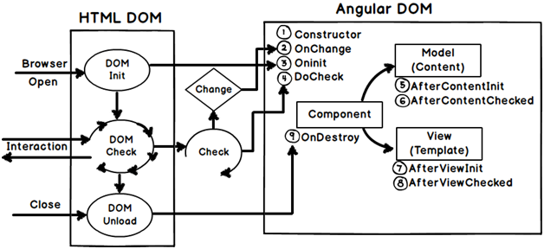
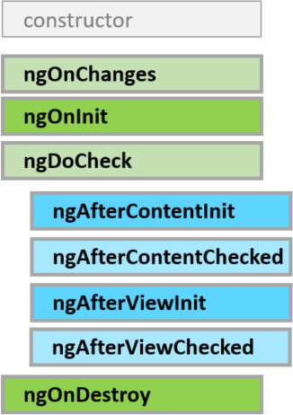
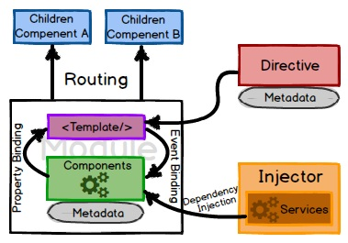
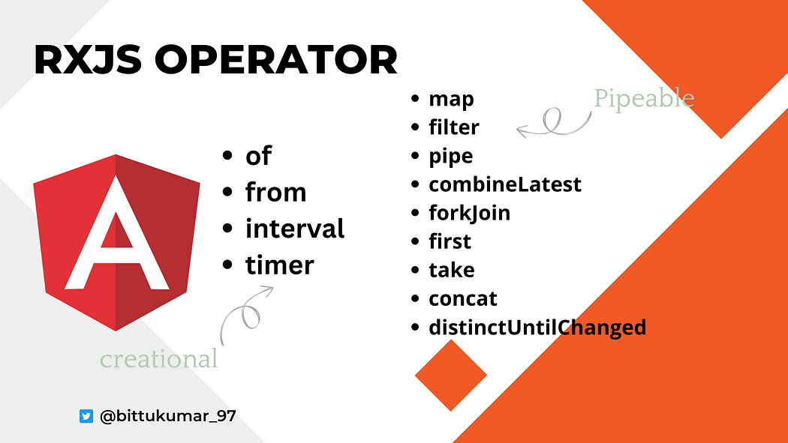
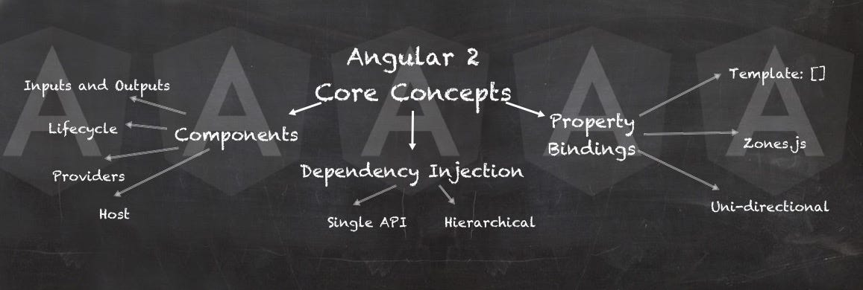
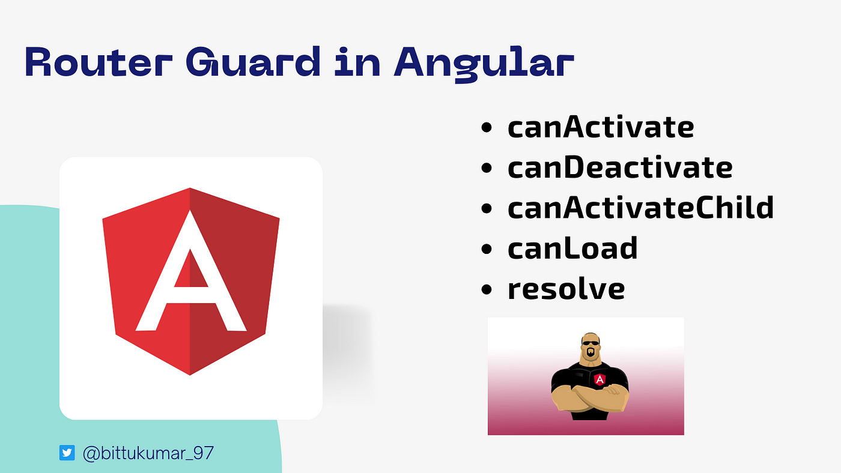
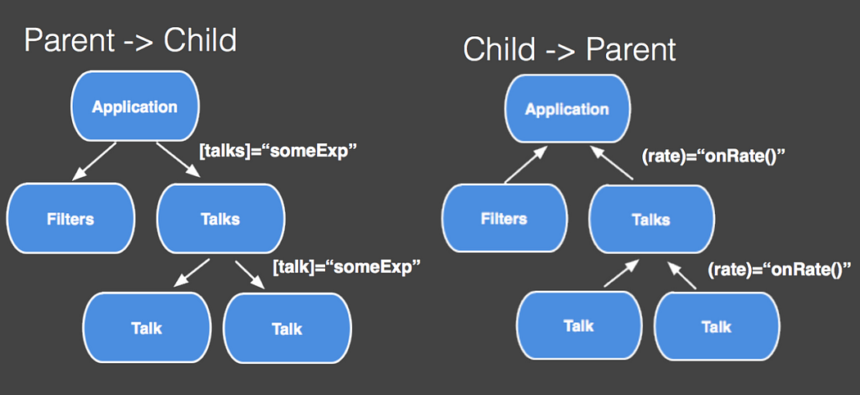
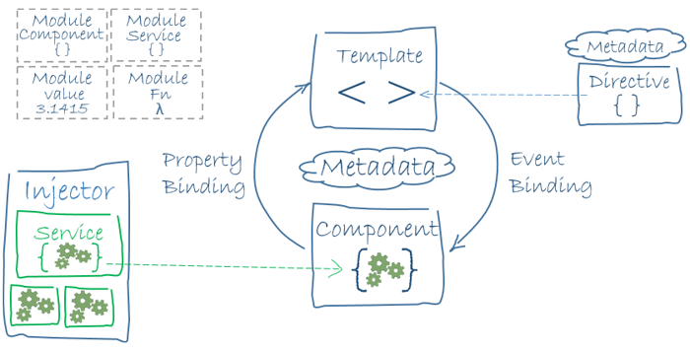
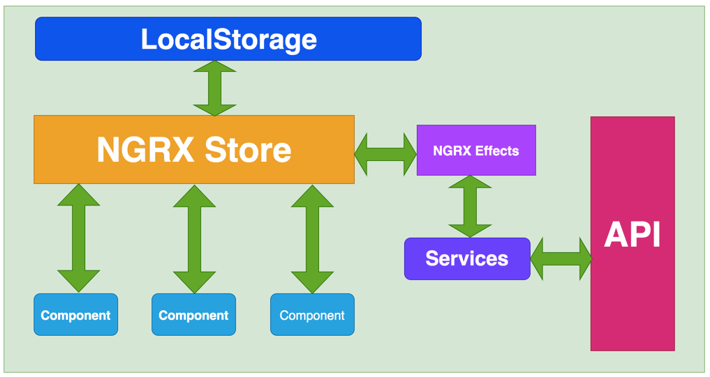
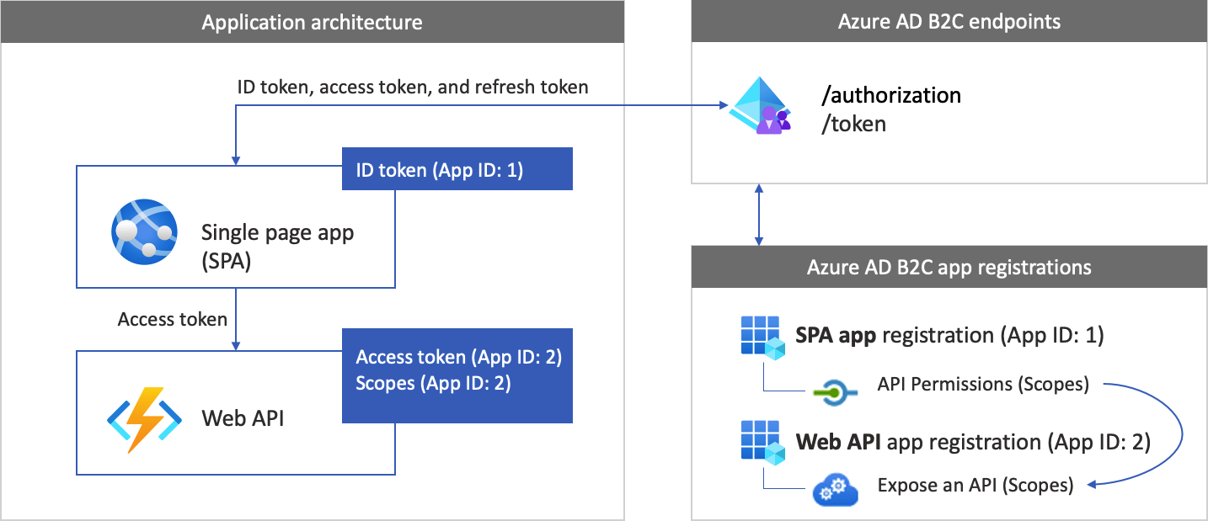
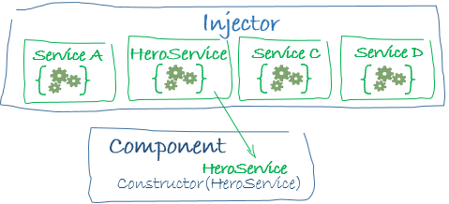
Nrwl Nx: A build system and monorepo management tool designed for Angular, React, NestJS, and other frameworks.
Notes:
https://learn.microsoft.com/en-us/azure/active-directory-b2c/configure-authentication-sample-angular-spa-app
https://dzone.com/articles/login-and-registration-aspnet-web-api-using-angula – Example (code)

Slide 8
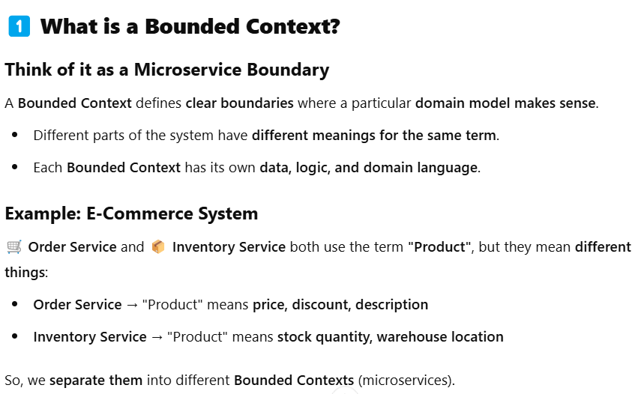

Slide 9
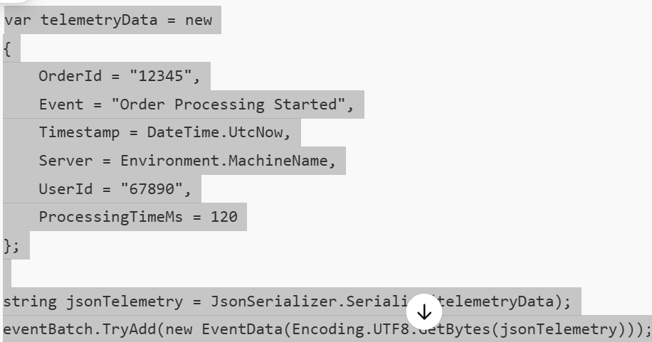
What is Telemetry Data?
Telemetry data refers to real-time, automated data collection from applications, services, or devices, which is then sent to a central location for monitoring, analytics, and decision-making.
✅ Purpose: Helps track application health, performance, usage patterns, and errors. ✅ Where is it used? IoT devices, cloud services, microservices, AI-driven insights, etc.

Slide 10
Domain-Driven Design (DDD) best practices while implementing Event-Driven Architecture (EDA) using Azure Event Grid and Azure Log Analytics for telemetry

Slide 11
Order Service (Start Transaction) | Payment Service (Saga Coordinator) | Shipping Service (Check Availability)
1️⃣ Order Service (Start Transaction) Generates a Correlation ID (X-Correlation-ID) for tracking. Publishes OrderPlaced event to Azure Service Bus. Listens for OrderFailed (if rollback is needed). 🔗 Connected To: Payment Service Event Grid for UI Updates | 2️⃣ Payment Service (Saga Coordinator) Listens for OrderPlaced. Tries payment processing. Success → Publishes PaymentProcessed event. Failure → Publishes PaymentFailed event → Triggers rollback. 🔗 Connected To: Shipping Service (via PaymentProcessed) Order Service (publishes OrderFailed if rollback needed) | 3️⃣ Shipping Service (Check Availability) Listens for PaymentProcessed. Checks if shipping is available in the area. Success → Publishes OrderShipped event. Failure → Publishes ShippingFailed event → Triggers rollback. 🔗 Connected To: Event Hub for Telemetry Order Service for Rollback

Slide 12
4️⃣ Rollback & Compensation Handling
Case 1: Payment Failure 🚨 If payment fails: Publishes PaymentFailed event. Order Service listens and triggers compensation. Order Status Updated → "FAILED" (UI notified via Event Grid). | Case 2: Shipping Restriction 🚨 If shipping fails (e.g., area not covered): Publishes ShippingFailed event. Payment is refunded (Compensation logic in Payment Service). Order is marked "FAILED" and customer notified

Slide 13
🔹 Best Practices for Distributed Rollback: ✅ Use Correlation ID – Tracks operations across services. ✅ Compensating Transactions – Instead of rolling back, create a reversing event. ✅ Eventual Consistency – Ensure all services reflect the final state asynchronously. ✅ Outbox Pattern – Ensures messages are reliably published to avoid inconsistencies.

Slide 14
🔒 Security & Compliance Comparison
Feature | Azure Service Bus + MassTransit | NServiceBus + Azure Service Bus
Built-in Encryption | ❌ No (Need Azure Service Bus encryption) | ✅ Yes (Message encryption out-of-the-box)
Data-at-Rest Encryption | ✅ Yes (Azure-managed encryption) | ✅ Yes (Azure-managed encryption)
Data-in-Transit Encryption | ✅ Yes (TLS 1.2/1.3) | ✅ Yes (TLS 1.2/1.3)
Message Auditing | ❌ No (Needs custom logging) | ✅ Yes (Built-in with ServiceControl)
Automatic Retries & Circuit Breaking | ✅ Yes (Configurable retries) | ✅ Yes (Intelligent retries & circuit breaker)
Saga / Workflow Management | ⚠️ Basic (via state machines) | ✅ Advanced (Automatic timeout handling, state persistence)
Dead-Letter Queue (DLQ) | ✅ Yes (via Azure Service Bus) | ✅ Yes (with detailed failure tracking)
Compliance Standards (ISO, HIPAA, GDPR, PCI-DSS, etc.) | ✅ Possible (Requires manual setup) | ✅ Yes (Built-in auditing & compliance tools)

Slide 15
Why Azure Service Bus + MassTransit? 🔹 Fully managed (PaaS) → No need to manage infrastructure. 🔹 Guaranteed message delivery → Orders, payments, and inventory updates won’t be lost. 🔹 Supports Pub/Sub & FIFO Queues → Ensures order processing sequence. 🔹 Works well with .NET & Azure ecosystem → Easier integration with your cloud setup. 🔹 MassTransit handles retries, sagas, and distributed transactions → Helps in managing order workflow, payments, and shipping processes efficiently.
Microservice | Messaging Use Case | Best Choice
Orders | Order placed → Payment processing | Azure Service Bus (Guaranteed delivery)
Payments | Payment success → Inventory update | MassTransit (Saga pattern for consistency)
Inventory | Stock update → Notify customers | Azure Service Bus (Pub/Sub for real-time updates)
Shipping | Order shipped → Notify user | Azure Service Bus + MassTransit
Notifications | Send email/SMS on order updates | Azure Event Grid (For real-time notifications)

Slide 16
When a customer places an order, the system should: 1️⃣ Order Service sends a message to Azure Service Bus. 2️⃣ Payment Service listens for "New Order" messages and processes payment. 3️⃣ Inventory Service listens for "Payment Success" and updates stock. 4️⃣ Shipping Service listens for "Order Ready" and dispatches shipment.
Use Case | Best Choice | Why?
Payment Processing | 🚀 Azure Service Bus | Ensures FIFO, retries, and transactional consistency
Order Status Updates | ✅ Event Grid | Real-time fan-out to multiple subscribers
Stock Updates | ✅ Event Grid | Multiple consumers can react to stock changes
Microservices Communication | 🚀 Azure Service Bus + MassTransit | Reliable service-to-service messaging
Real-time User Notifications (Webhooks, Push, Email) | ✅ Event Grid | Publishes events to multiple services

Slide 17
1️⃣ Business & Technical Assessment
✅ Understand Business Goals → Why move to microservices? (Scalability, performance, agility, cost, etc.)
✅ Analyze Existing Monolith → Identify tightly coupled services, pain points, and dependencies.
✅ Assess Readiness → Skills, team maturity, DevOps practices, and cloud adoption maturity.
________________________________________
2️⃣ Define Strategy & Roadmap
✅ 6R Strategy (Refactor, Rehost, Replatform, etc.) → Choose the best migration approach.
✅ Domain-Driven Design (DDD) → Identify bounded contexts & design microservices around business capabilities.
✅ Strangler Fig Pattern → Migrate step-by-step instead of a full rewrite.
________________________________________
3️⃣ Azure Foundation Setup
✅ Azure Landing Zone (ALZ) → Set up networking, security, IAM, and governance.
✅ Cloud Adoption Framework (CAF) → Align with best practices for governance and operations.
✅ Azure Well-Architected Framework (WAF) → Optimize cost, security, reliability, and scalability.
________________________________________
4️⃣ Microservices Architecture Design
✅ Service Boundaries → Define APIs, contracts, and inter-service communication.
✅ Database Strategy → Choose between data sharding, CQRS, and polyglot persistence.
✅ Security (Zero Trust Model) → Use OAuth2, OpenID Connect, Duende Identity Server for authentication.
✅ Resilience & Observability → Implement logging, monitoring (App Insights, Prometheus, ELK).
________________________________________
5️⃣ DevOps & CI/CD Pipeline
✅ Containerization → Use Docker + Kubernetes (AKS) for deployment.
✅ CI/CD → Automate with Azure DevOps, GitHub Actions, or Jenkins.
✅ API Gateway → Use Azure API Management (APIM) for security and traffic control.
________________________________________
6️⃣ Migration & Rollout Plan
✅ Start with Non-Critical Services → Pilot migration with less business-impacting services.
✅ Feature Flags & Canary Releases → Gradually migrate traffic with minimal downtime.
✅ Rollback & Monitoring Strategy → Use Azure Monitor, Log Analytics for real-time tracking.

Slide 18
Factor | IdentityServer4 | Duende IdentityServer
Security Updates | ❌ No updates (deprecated) | ✅ Regular updates
Compliance (FAPI 2.0, GDPR, etc.) | ❌ No official compliance | ✅ Certified & compliant
Support | ❌ Community support only | ✅ Official enterprise support
Long-Term Viability | ❌ No future .NET updates | ✅ Actively maintained
Ease of Use & Secure Defaults | ❌ Manual setup required | ✅ Preconfigured security settings
Cloud & Enterprise Readiness | ❌ Limited cloud integration | ✅ Cloud-native support

Slide 19
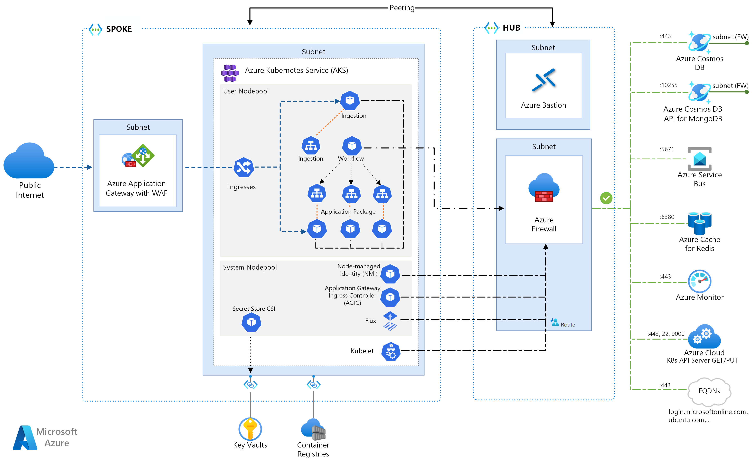

Slide 20
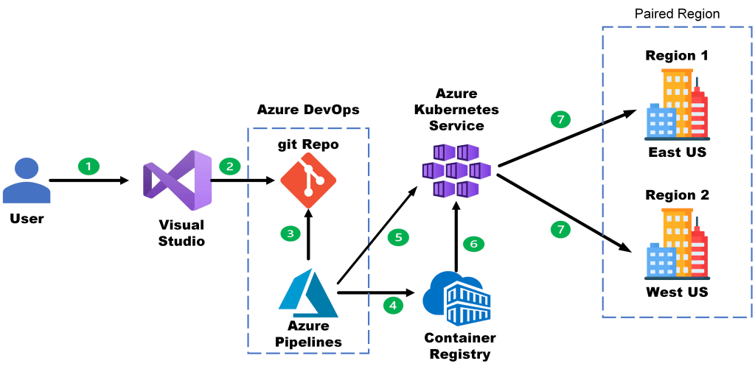

Slide 21
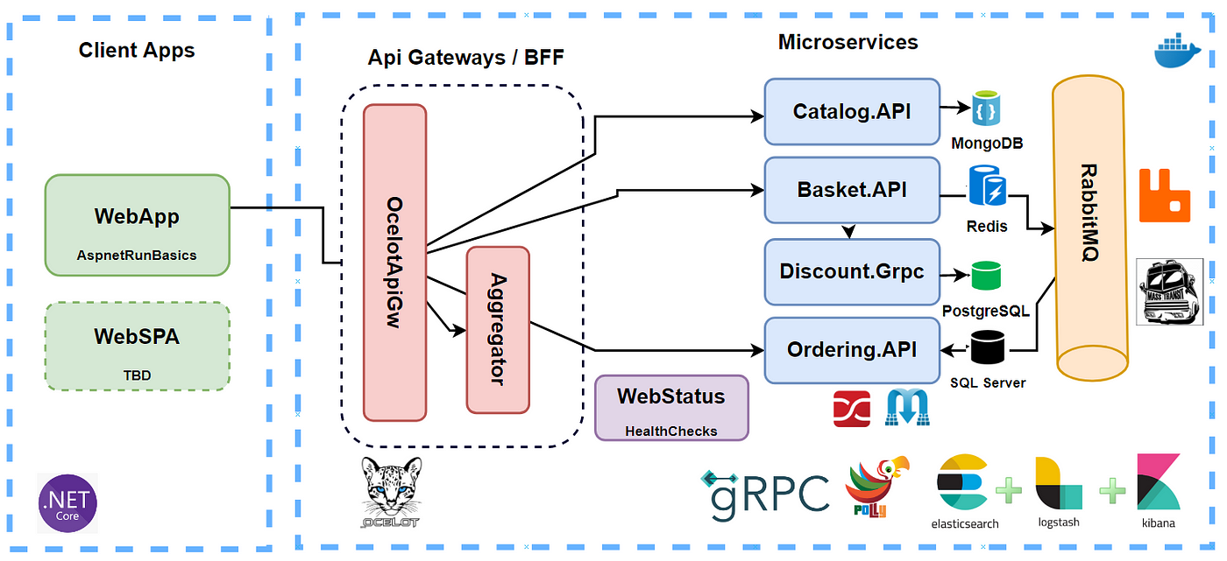
High available & Scalable architecture Microservices Architecture
12 Factor Microservice Rule
Authentication and Authorization, Encryption ( IdentityServer, OAuth 2.0, JWT), SSL/TLS
API Gateway(Ocelot, Azure API Management)
Logging and Monitoring (ELK Stack (Elasticsearch, Logstash, Kibana)/ New Relic, Azure application Insight, log Analytics
Service Discovery (Consule, Kubernetes Services)
Fault Tolerance(Circuit Breakers-Polly, retries, timeouts)
Database Scaling (sharding, replication)
Load Balancing-Kubernetes Ingress Controllers, Azure load balancer
Distributed Tracing(Application Insights, OpenTelemetry)
Autoscaling (Kubernetes Horizontal Pod Auto scaler (HPA)
Microservices Communication- RESTful APIs, gRPC, Messaging Queues (RabbitMQ, Kafka)
Health Checks - Kubernetes Probes, ASP.NET Core Health Checks, Consul Health Checks
Containerization(Docker, Docker Swarm),Orchestration – Kubernetes
Continuous Integration/Continuous DeploymentCI/CD) -Jenkins, Github, Azure DevOps
Infrastructure as Code (IaC) – Terraform, ARM Template, Bicep
Async, Middleware, SonarQube, Resharper. Code Analysis, Branching Strategy

Slide 22
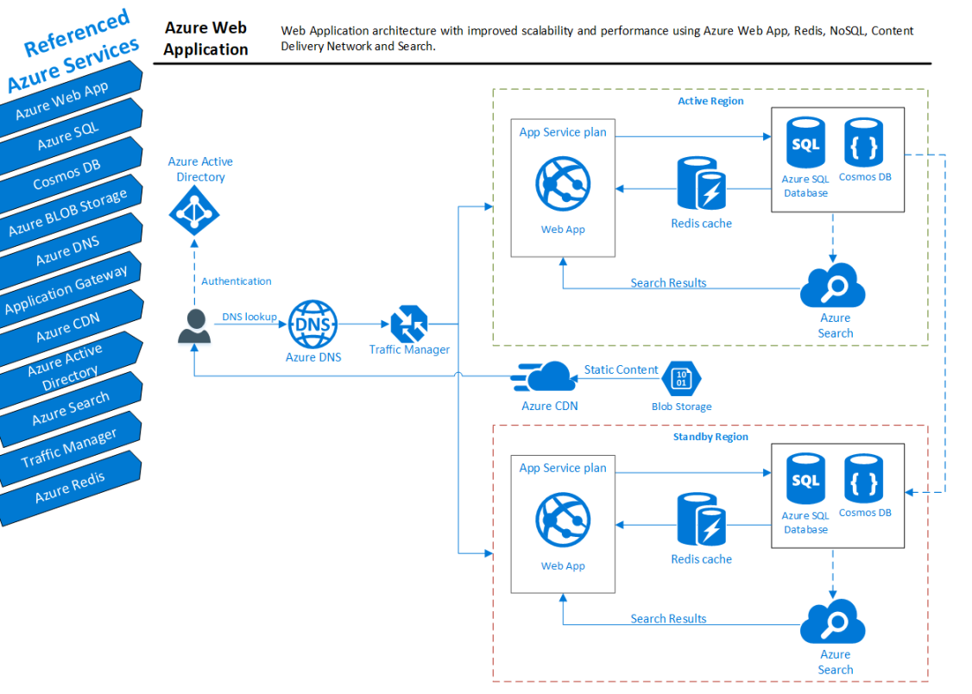

Slide 23
Azure API Management

Slide 24


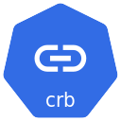


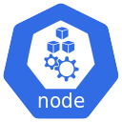


Azure Active Directory & Kubernetes RBAC
Authentication
k8s Cluster Role
Azure AKS Kubernetes Cluster
Cluster Role Binding
k8s Cluster Role Binding
Azure Active Directory
Cluster Role
Integrate Azure AD Group & Kubernetes RBAC
User / Group
(Subject)
Get
(Verb)
Azure AD Group: aksreadonly
Access
Granted
(Resources)
Object ID: e6dcdae4-e9ff-42
61-81e6-0d08537c4cf8
4
3
Credentials Cached
kubectl get nodes
1
2
Read Only User
Terminal
Azure AD User: aksread1
Your Desktop

Slide 25
1. Scalability
Azure Autoscaling
Azure Front Door
Load Balancer
Handling flash sales & high traffic spikes
Azure AKS (Scale Up & Down)

Slide 26
2. Security
Authentication & Authorization: Azure AD B2C, OAuth 2.0, APIM, WAF
Identity Management: Azure AD B2C, Identity Server 4, App Registration, JWT, OAuth, OpenID, HTTPs, gRPC, OWIN
Key Vault & Secrets Management: System & Managed Identity, Access Policy, Soft Delete, Purge Protection
API Security: Fraud Detection, API Gateway (Ocelot, APIM), API Key Management

Slide 27
3. Flexibility & Reliability
Design Patterns: GOF, Clean Architecture, DDD, CQRS, Retry & Circuit Breaker (Polly)
Integration & Messaging: Ocelot API Gateway, APIM, Event Grid, Event Hub, Service Bus, ESB, RabbitMQ, Kafka
Fault Tolerance: Throttling, Threading
Backup & Disaster Recovery: Code Backup, DB Backup, VM Backup, RTO, RPO
Elasticity: CPU, Memory, Storage, App Service Plan, VMSS, Elastic Pool (DB)

Slide 28
4. Logging & Monitoring
Tools: ElasticSearch, Logstash, Kibana, Azure Log Analytics, Azure Application Insights, Azure Monitor
Distributed Tracing: Correlation ID, Telemetry
5. Caching & Performance
Caching Mechanisms: Redis Cache, CDN, Output, Data, Fragment, Donut, In-Memory
Latency Optimization: CDN, Caching (Redis), CQRS, Azure Service Bus
Performance Testing: API Health Checks, Monitoring, Alerts

Slide 29
6. API Management
API Versioning & Revision
Async Communication & Transactions
API IP Address Management
API Testing (Unit Testing, Code Coverage, Resharper)
7. Deployment & DevOps
CI/CD Pipelines: Azure DevOps, Terraform, ARM Templates
Deployment Strategies: Blue-Green Deployment, Canary Releases, One-Click Deployment
Secure DevOps: Secrets in Azure Key Vault, Infrastructure as Code (IaC)
Multi-region Deployment: Availability Set, Availability Zone
Azure Resource Management: Subscription, Resource Group, Tenant

Slide 30
8. Azure Services & Architecture
Compute & Serverless: Azure App Services, Azure Functions, Azure Logic Apps, Azure API Management
Data & Storage: Azure SQL Database, Azure Cosmos DB (Eventual Consistency, Strong Consistency)
Messaging & Event-Driven Architecture: Event Sourcing, SAGA Pattern, Outbox Pattern, Azure Event Grid, Event Hub, Service Bus, RabbitMQ, Kafka
Load Balancing: Azure Application Gateway, Load Balancer, Traffic Manager, WAF
Three-Tier Architecture: Hub-Spoke Model

Slide 31
9. Identity & Access Management
Azure AD B2C: Tenant Creation, User Flow (Sign-Up, Sign-In, Password Reset)
App Registration: Identity Provider Configuration, API Permissions, JWT Token Handling
Graph API Integration: Authentication across multiple APIs
10. AI & Automation
AI Services: Cognitive Services, AI Search, Vision API, Azure OpenAI, AI Bot Services
Automation & Scheduling: Azure Logic Apps, Scheduled Batch Jobs, DevOps CICD Pipeline

Slide 32
11. Development & Testing
Unit Testing Frameworks: MOQ, NUnit, xUnit
Rest API Testing: Postman, Swagger, Resharper
Git & Version Control: Git, GitLab, GitHub, Git Clone
12. Azure Messaging & Event Handling
Azure Messaging Services: Event Grid, Event Hub, Service Bus
Event-Driven Architecture: CQRS, Event Sourcing, Integration with Messaging Systems
Serverless Functions: Azure Functions for event processing

Slide 34
Logging & Monitoring, Healthcheck, Alert Messge etc

Slide 35
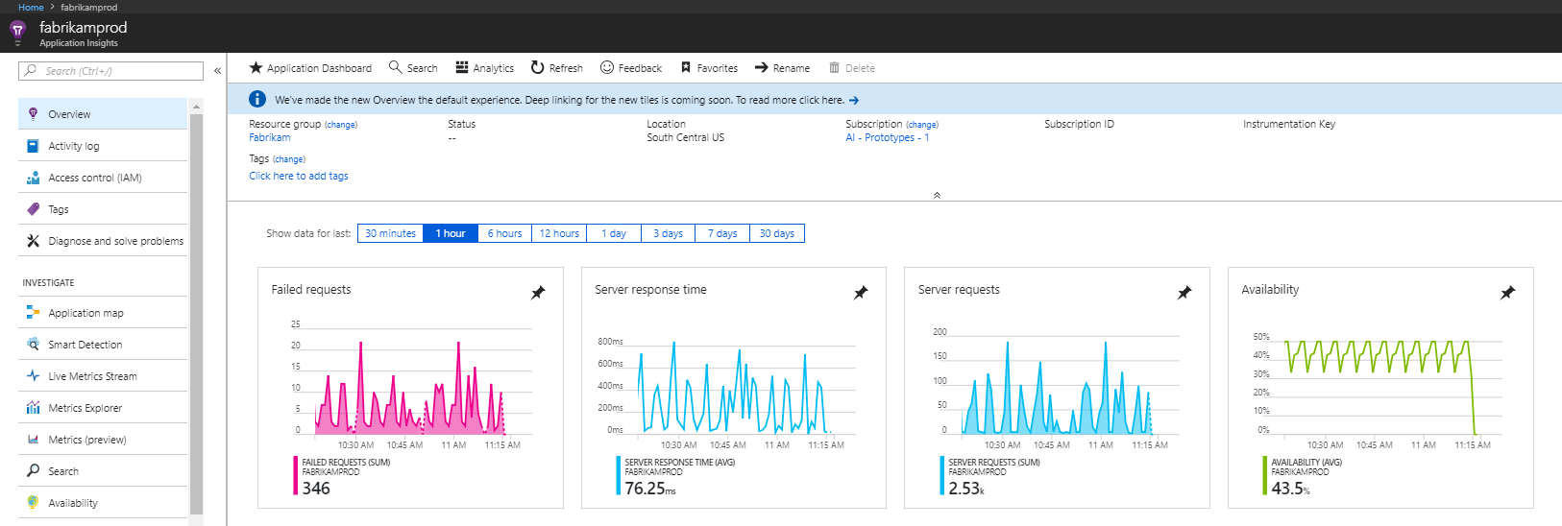
Azure application insight
Application Insights is an extension of Azure Monitor and provides application performance monitoring (APM) features. APM tools are useful to monitor applications from development, through test, and into production in the following ways: Proactively understand how an application is performing.

Slide 36
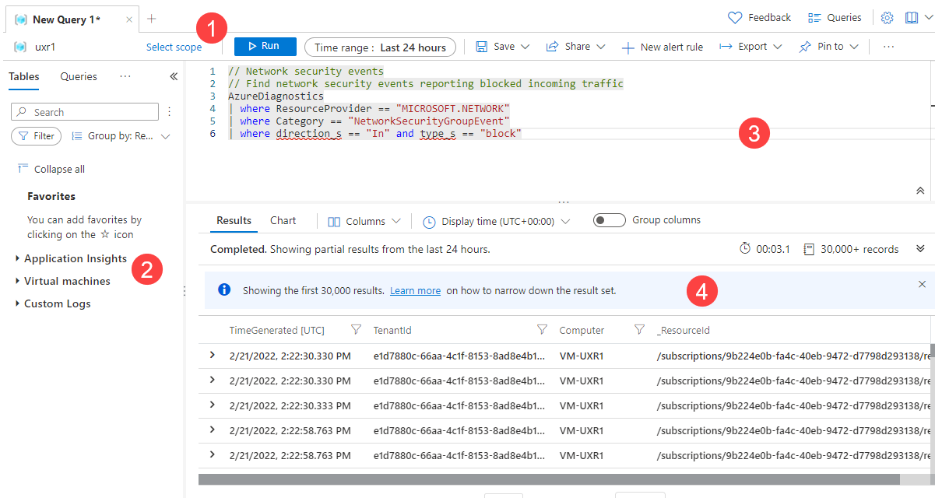
Azure Log Analytics

Slide 37
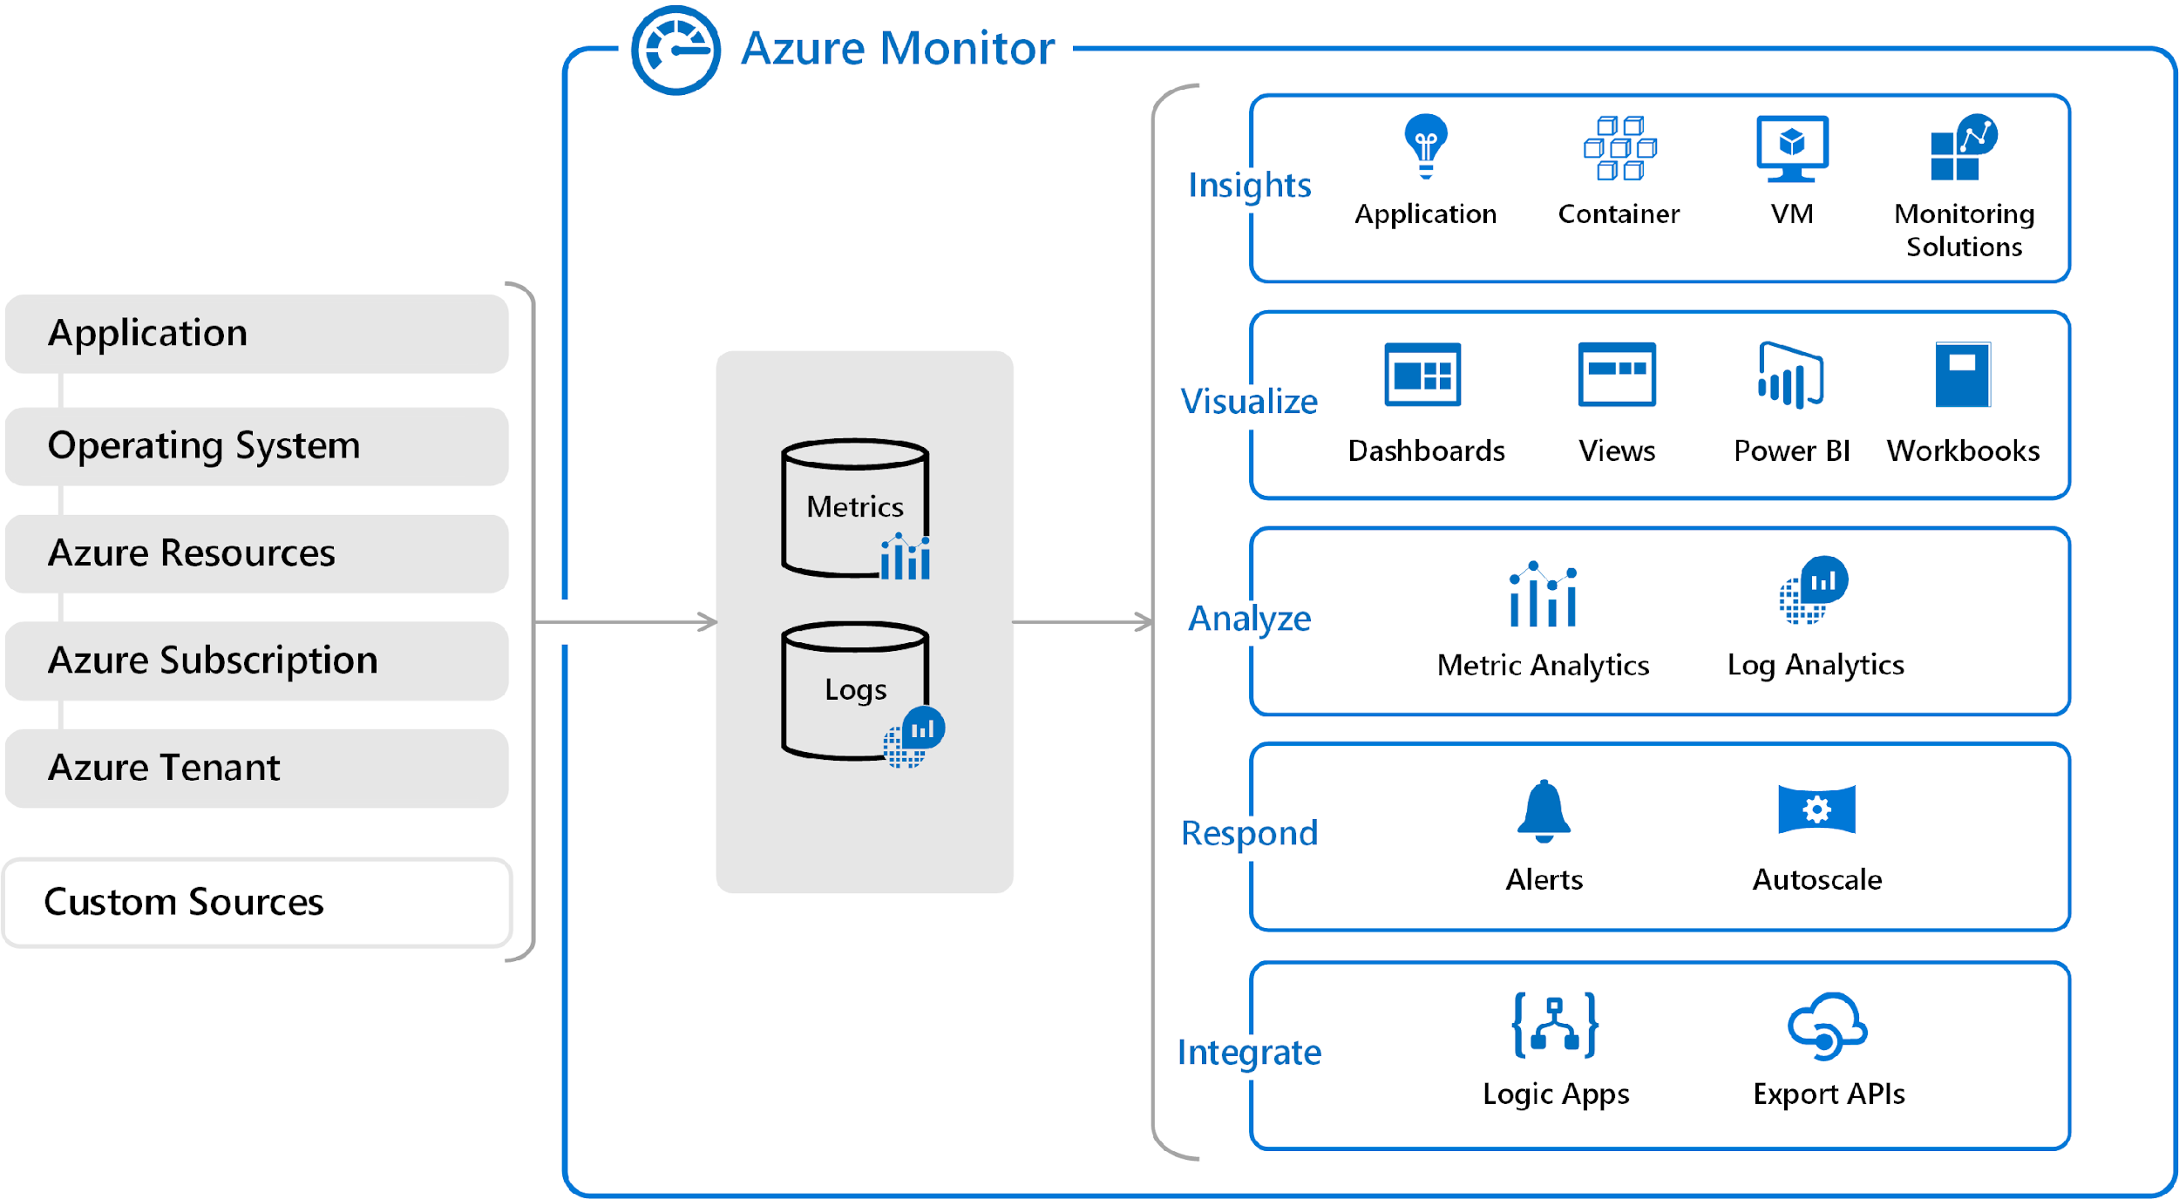

Slide 38
Cost-Benefit Analysis
Key components: User Management, Catalog, Cart, Payment, Order Processing, Inventory
High-level architecture with .NET Core Microservices & Azure
Cloud-native vs. hybrid approaches

Slide 39
Slide 3: Key Challenges in E-Commerce & Resolution
Scalability (Handling flash sales, high traffic spikes)
Azure Autoscaling, Azure Front Door, Load Balancer
Security (Handling fraud detection, API security)
Azure AD B2C, OAuth 2.0, APIM, WAF
High Availability & Resilience
Multi-region deployment, Azure Cosmos DB, Event-driven architecture
Performance & Latency
CDN, Caching (Redis), CQRS, DDD, Azure Service Bus
Data Consistency
Event Sourcing, SAGA Pattern, Outbox Pattern

Slide 40
Slide 4: Solution Architecture - .NET & Azure Cloud
.NET Microservices with Azure
API Gateway (Azure APIM)
Backend Microservices (Order, Payment, Inventory)
Azure SQL, Azure Cosmos DB
Authentication & Authorization
Azure AD B2C, OAuth, JWT tokens
Logging & Monitoring
ELK Stack (Elasticsearch, Logstash, Kibana), Azure Monitor, App Insights

Slide 41
Slide 5: DevOps Strategy for E-Commerce
CI/CD using Azure DevOps
Blue-Green Deployment, Canary Releases
Infrastructure as Code (Terraform, ARM templates)
Secure DevOps practices (Secrets in Azure Key Vault)

Slide 42
Slide 6: Real-world Case Studies & Demo
Case Study of an E-Commerce Platform handling millions of transactions
Live Demo: Deploying a microservice to Azure AKS with API Gateway

Slide 43
Slide 7: Hands-on Challenges & Solutions
Real-world problem-solving session
How to troubleshoot performance bottlenecks
Handling failures in a distributed microservices system
Using Polly for resilience (Retry, Circuit Breaker)

Slide 44
Slide 8: Best Practices & Takeaways
Do’s and Don’ts in architecting e-commerce on .NET & Azure
How to future-proof your architecture
Recommendations on cost optimization & governance

Slide 45
Slide 9: Q&A and Workshop Closure

Slide 46
1. Azure Service Bus
🛠️ What is it?
A fully managed message broker (PaaS) by Microsoft for enterprise-grade messaging.
Supports Pub/Sub, FIFO, and transactional messages.
Used for hybrid cloud solutions (on-premises to cloud communication).
✅ When to Use Azure Service Bus?
✔ Need managed messaging without running a broker. ✔ Enterprise applications requiring high durability and at-least-once delivery. ✔ Cross-region, cross-cloud, or hybrid solutions. ✔ Built-in message ordering, deduplication, and dead-lettering needed.
❌ When NOT to Use?
❌ If you need lightweight, high-speed messaging → Use RabbitMQ. ❌ If you prefer on-premise control → Use RabbitMQ or Kafka. ❌ If cost is a major issue (Azure Service Bus pricing is higher for high throughput).

